Slide 1
Speech accent archive
.

Slide 2
motivation
Everyone who speaks a language, speaks it with an accent. A particular accent essentially reflects a person's linguistic background. When people listen to someone speak with a different accent from their own, they notice the difference, and they may even make certain biased social judgments about the speaker.
The speech accent archive is established to uniformly exhibit a large set of speech accents from a variety of language backgrounds.
We do this prediction using CNN.

Slide 3
Dataset description
Speech Accent Archive dataset contains 2140 speech samples, each from a different talker reading the same reading passage.
Talkers come from 177 countries and have 214 different native languages.
Each talker speaks in English.
Csv file has following labels: age_onset, birthplace, filename(audio), native_language, sex, speakerid, country,

Slide 4
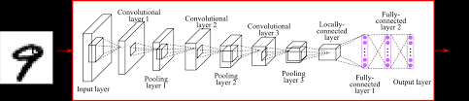
Architecture

Slide 5
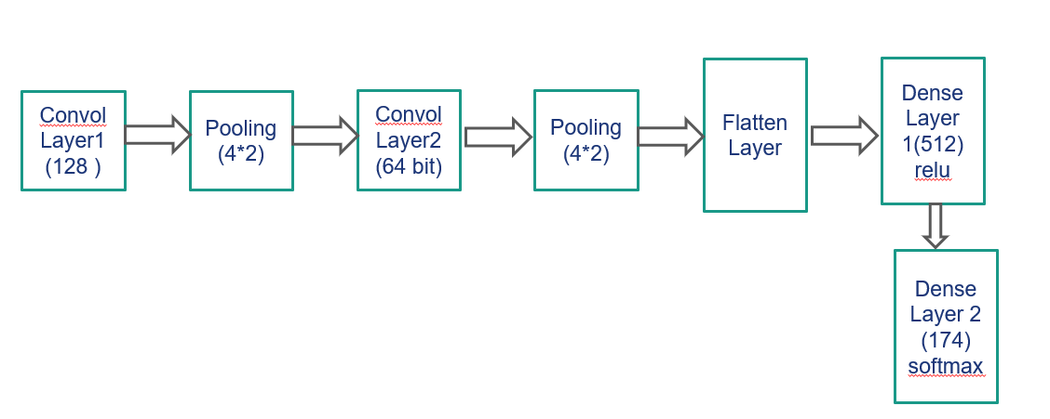
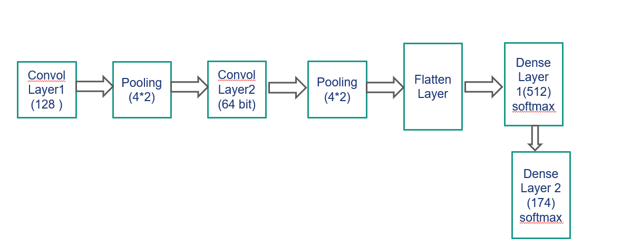
Overall Architecture

Slide 6
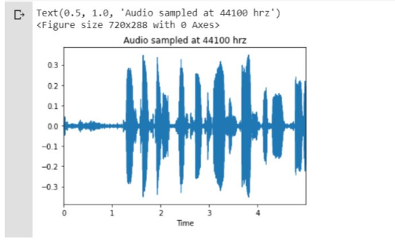
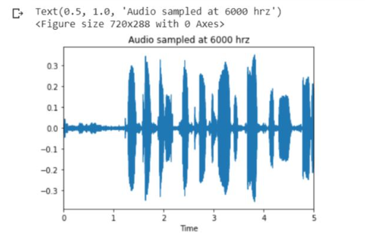
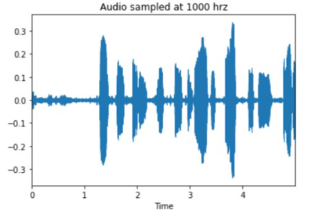
Audio wave

Slide 7
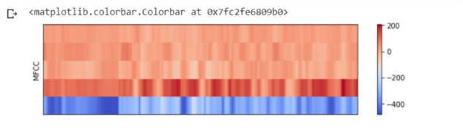
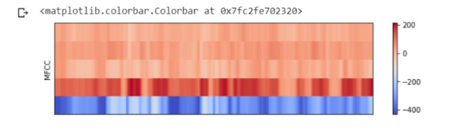
mfcc

Slide 8
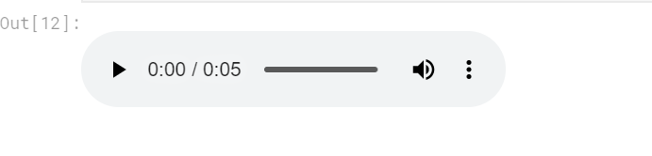
HPSS (Harmonic-percussive source separation

Slide 9
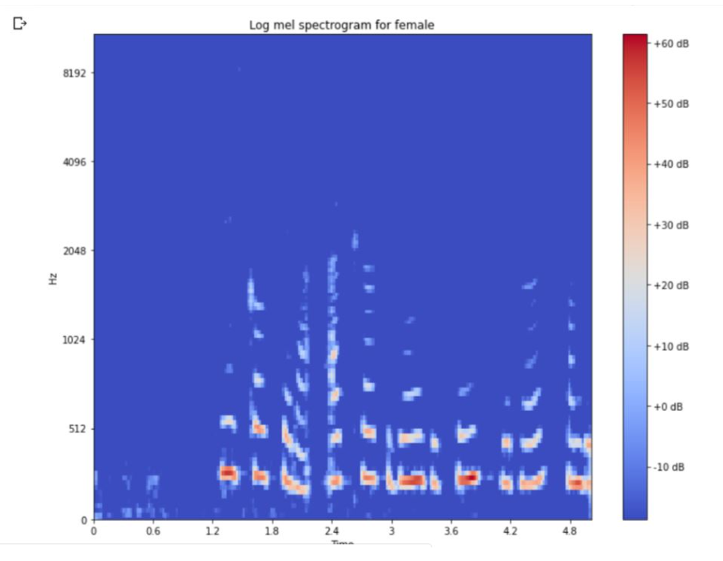
Log-Mel Spectogram

Slide 10
solution
Convolutional input layer, 24 feature maps with a size of 5x5, a relu activation function and a weight constraint of max norm set to 3.
Dropout set to 20%.
Convolutional layer, 48 feature maps with a size of 5x5, a relu activation function and a weight constraint of max norm set to 3.
Max Pool layer with size 4x2.
Flatten layer.
Fully connected layer with 512 units and a relu activation function.
Dropout set to 50%. Fully connected output layer with 174 units and a softmax activation function

Slide 11
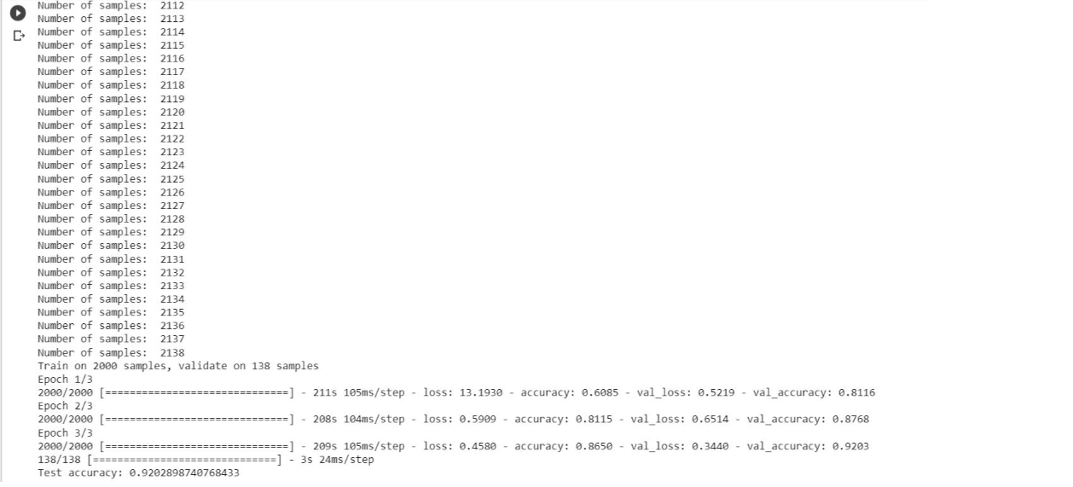
evaluation

Slide 12
Future work
We can improvise CNN model to recognize accent.
We can also try to change model architecture to get better results.

Slide 13

Thank you

